Slide 1
Coal Terminal Analysis Report
By: Tom Barasa
05/15/2022

Slide 2
Coal Terminal Analysis Report
You have been hired by a coal terminal to assess which of their coal Reclaimer machines require maintenance in the upcoming month.
These machines run literally around the clock 24/7 for 365 days a year. Every minute of downtime equates to millions of dollars lost revenue, that is why it is crucial to identify exactly when these machines require maintenance(neither less or more frequently is acceptable).
Currently the coal terminal follows the following criteria: A reclaimer-type machine requires maintenance when within the previous month there was at least one 9-hour period when the average idle capacity was over 10%. Idle capacity is a utilization metric which, for the purpose of this project is defined as:
Idle capacity =(Actual Tonnage – Nominal Capacity)/Nominal Capacity.
Your task is to find out which of the 4 machines have exceeded this level and create a report for the executive stakeholders with your recommendations.

Slide 3
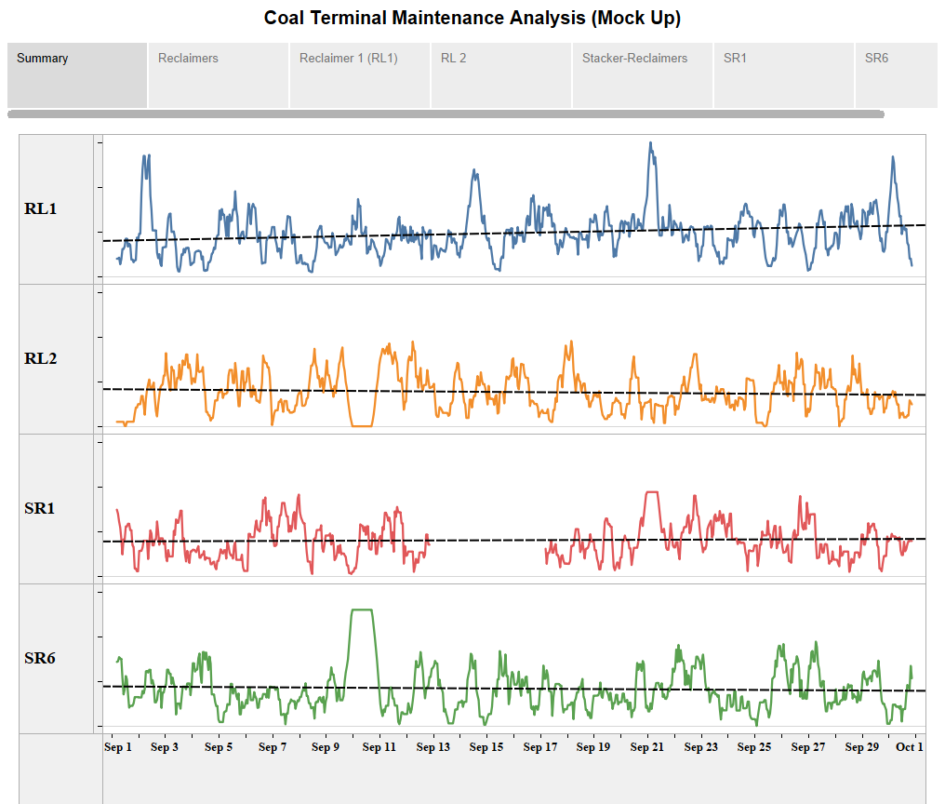

Slide 4
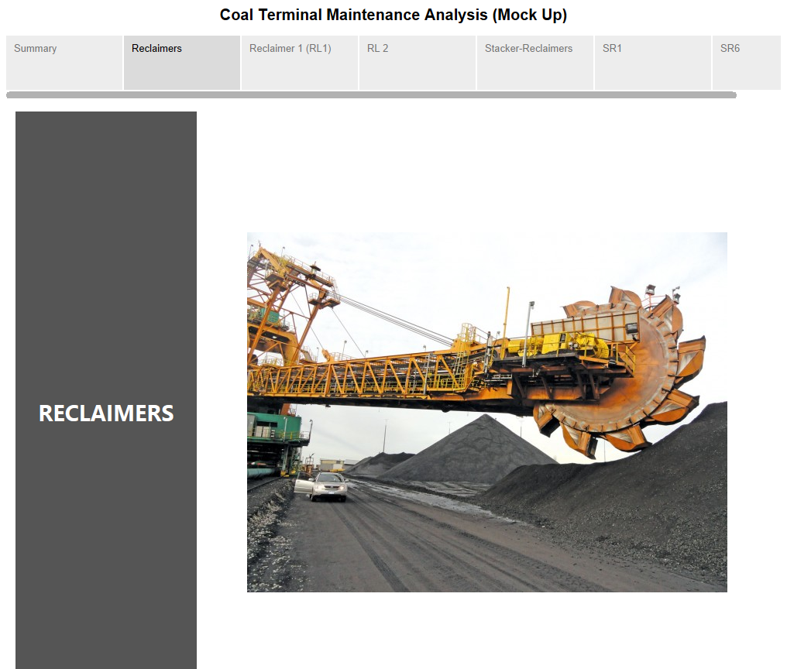

Slide 5
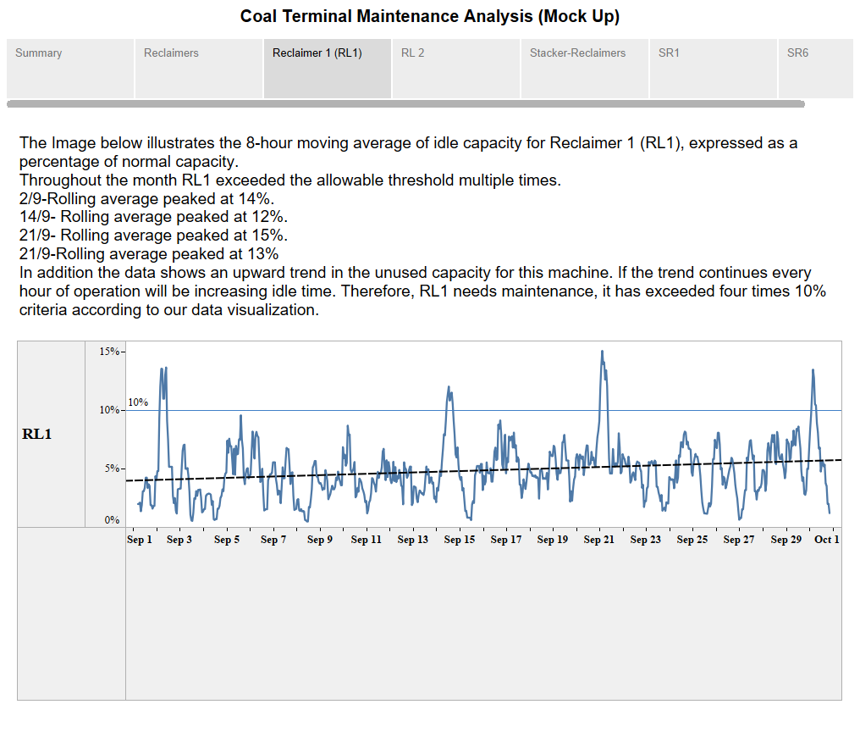

Slide 6
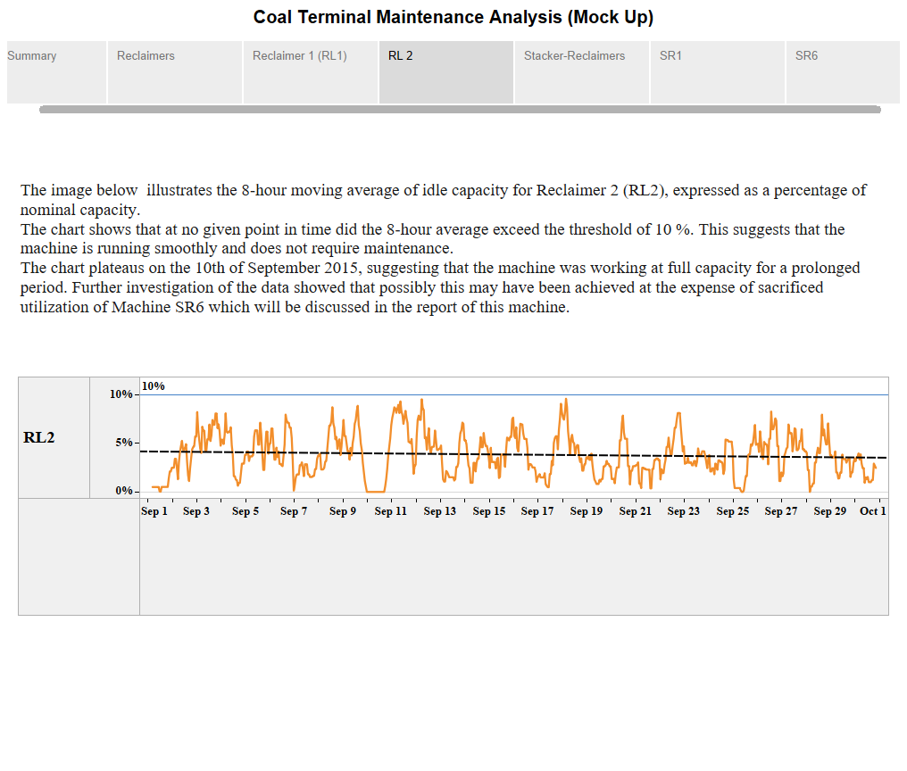

Slide 7
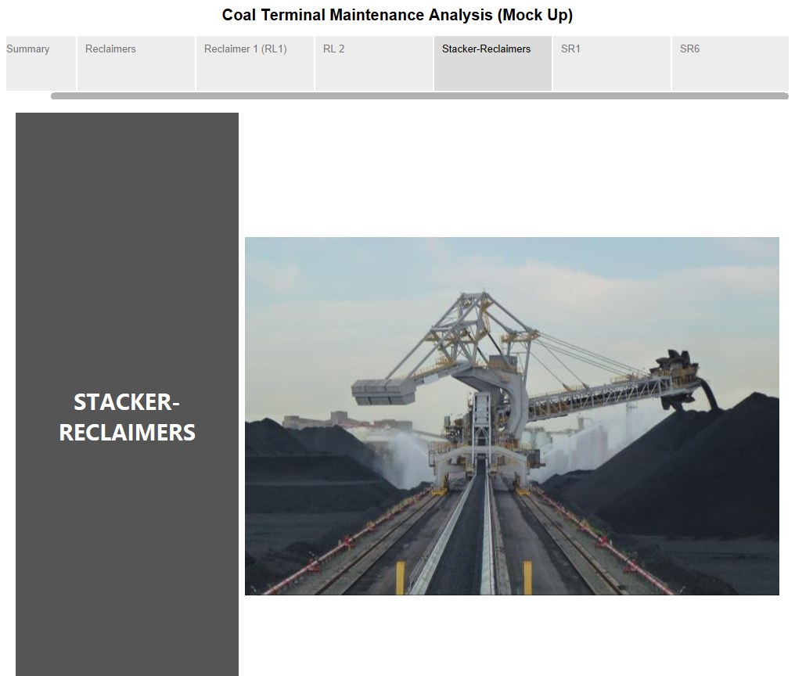

Slide 8
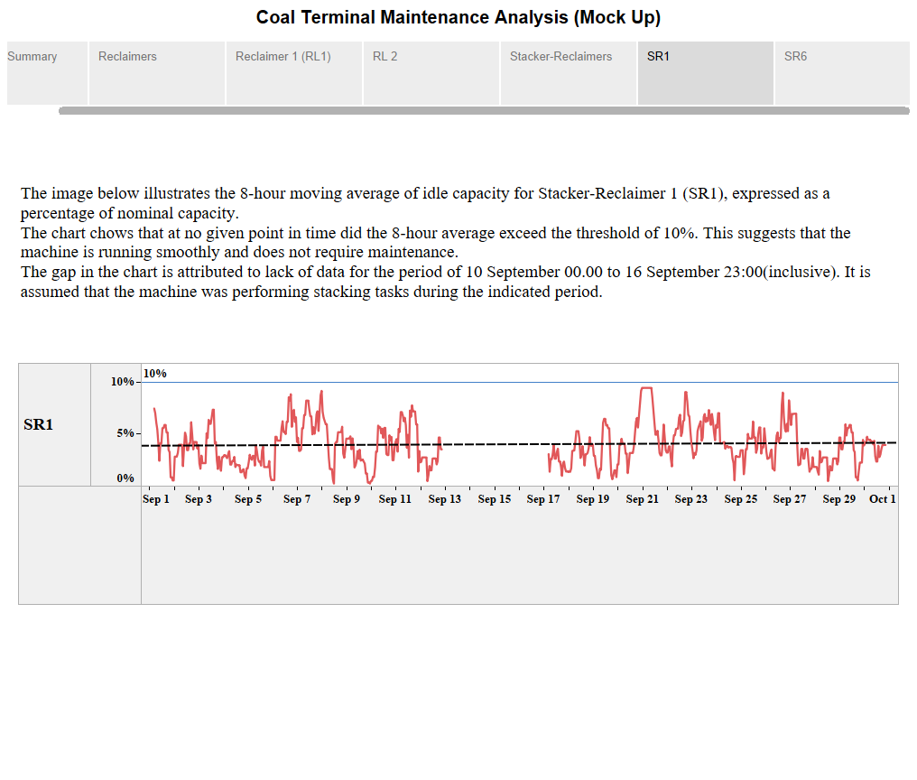

Slide 9
